Slide 1
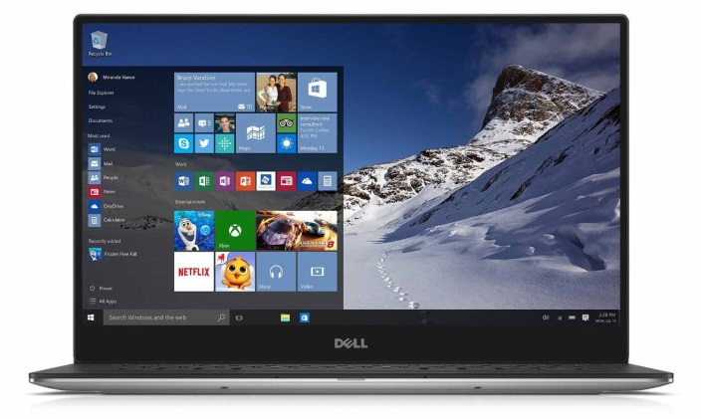
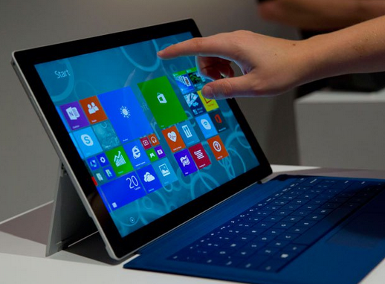
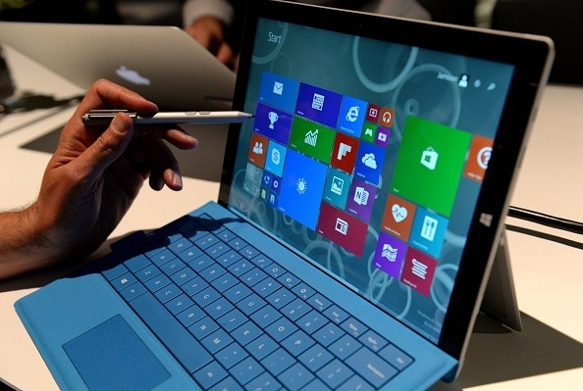
Touchscreen Laptops & Tablets
Both feature Windows 10
  Microsoft Office 2016
  Lync was replaced with Skype for Business
  Adobe Acrobat Pro is standard
  IE11, Microsoft Edge and Firefox browsers
  Docking Station
    Can use the same docking station as your current laptop with a mandatory spacer
    Tablet will have its own small docking station
  All Win10 devices are touchscreen
    Dell P3510 touchscreen laptop
    TBD Win10 tablet
Began Wave rollout in 2017.
  LAN only customers in District Offices &HQ
  Field VPN users in FY18
Learn more! Visit the Win10 Transition Page on InsideFSIS: https://inside.fsis.usda.gov/fsis/emp/static/centerContent/fsisPage.jsp?keyword=Windows101974 and via courses on AgLearn

